Slide 1
Child Tax Credits Both a non-refundable and a refundable credit
Pub 4012 – Pages G – 8 and G – 9
Pub 4491 – Part 5 – Lesson 26
Notes:
Pub 4491 Page 26-1
Pub 4012 Tab G
Form 1040 Lines 52, 67

Slide 2
Two Credits
#1: Child Tax Credit
Nonrefundable
If no amount on 1040 Line 47, will go to a Refundable credit
Up to $1,000 per qualifying child

Slide 3
Two Credits
#2 Additional Child Tax Credit
Refundable
Maximum Credit
15% of earned income over $3,000
Up to unused portion of child tax credit
Notes:
Both credits are phased out with Modified AGI > $75,000 ($110,000-MFJ or $55,000-MFS)
MAGI includes excluded foreign income and income from Puerto Rice and American Samoa

Slide 4
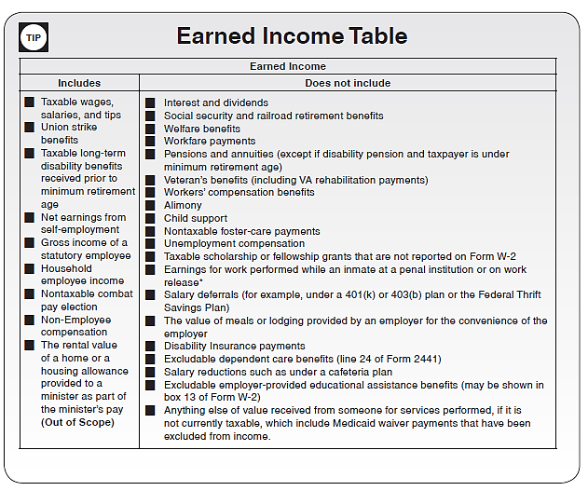
Earned income for CTC
Pub 4012 page I-1
Notes:
Recommend pen and ink changes to Pub 4012.
Note earned income includes disability pension if under retirement age
Combat pay is INCLUDED for CTC
Excludes taxable scholarships and penal income

Slide 5
Qualifying Child
Must be a dependent:
A qualifying child
NOT a qualifying relative
Under age 17
U.S. citizen, national or resident alien
Notes:
Canadian or Mexican citizen or resident doesn’t count.

Slide 6
Child of Divorced...Parents
Must be a dependent, so CTC goes with dependency to noncustodial parent
See also Form 8332

Slide 7
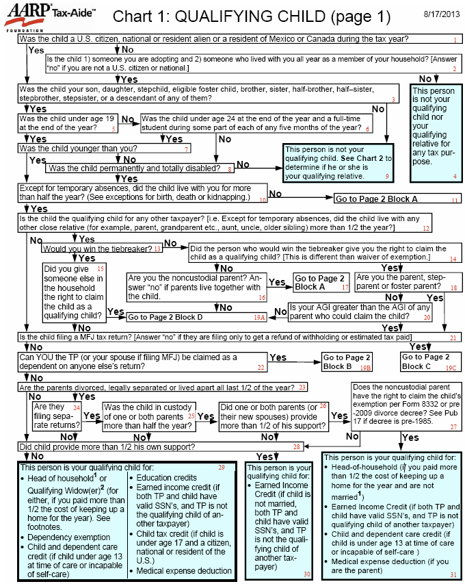
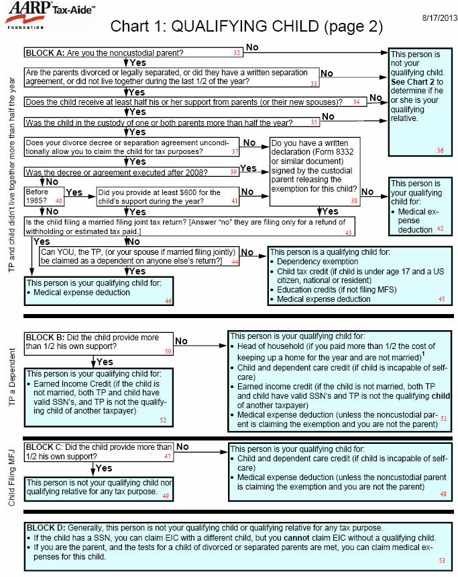
Qualifying Child Chart:
Notes:
Credits go with the dependency exemption. Must be qualifying child—not qualifying relative.

Slide 8
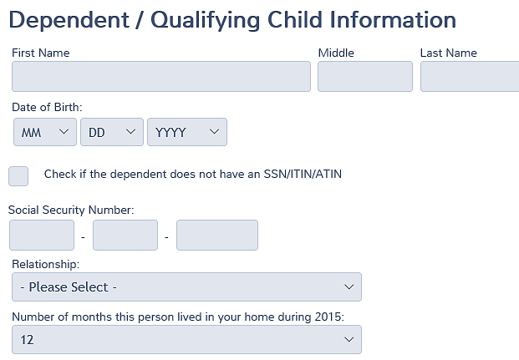
Entering in TaxSlayer
If the birthday is correct so the age is under 17...

Slide 9
Entering in TaxSlayer
and relationship makes him a qualifying child...

Slide 10
Entering in TaxSlayer
and he lived with taxpayer more than ½ the year...

Slide 11
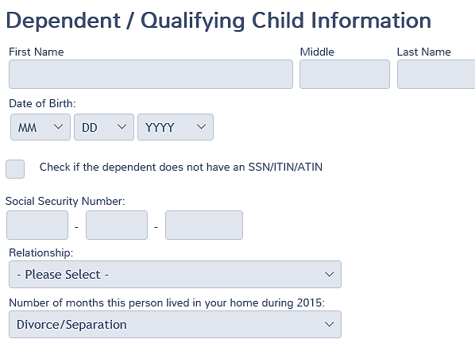
Entering in TaxSlayer
In case of divorce or separation the noncustodial parent enters “Divorce/Separation” from drop down menu
Notes:
In order to have the Child Tax Credit applied to the noncustodial parent, Divorce/Separated must be selected from the dropdown menu for number of months in the home.

Slide 12
Then...
TaxSlayer will calculate the credit
Notes:
If any income was earned by an inmate in a penal institution (including work release), the amount needs to be entered on Form 8812, Line 4a.

Slide 13
Note
Remind taxpayer that credit will disappear when child turns 17

Slide 14
Child Tax Credit
Questions?
Comments?

